Slide 1

STAT 413 (Statistical Learning) Project presentation Analyzing Student Performance Dataset
By Group 6:
Omer Alabs / 201769570
Ahmed Alturfi / 201743590
Omar Al Bumadrah / 201636140
Abdullah Mohmmed / 201740190

Slide 2
Overview
Data
Reviews
Data Preprocessing (Phase 1)
EDA
Methods
Linear Regression Modeling
Classification Modeling (I)
Classification Modeling (II)
Conclusions and Findings

Slide 3
Introduction
The data science study is based on a lot of branches starting from analyzing the data to building models and predicting based on the model, using our background in data science gained by the CX program we intend to perform analysis and study on the chosen data. As the starting point we developed a plan for the project to follow throughout the term, also we explore the chosen dataset and describe the dataset itself and each attribute in the dataset and discuss other related work on the dataset.

Slide 4
Data description
This data is collected from two different Portuguese schools regarding students' performance in the mathematics course and Portuguese language course. This dataset addresses many attributes that may be helpful in analyzing student performance. The dataset consists of 35 columns,649 rows.
Examples of some attributes definition:
Variable name | Description
school | binary: 'GP' - Gabriel Pereira or 'MS' - Mousinho da Silveira
Sex | binary: 'F' - female or 'M' - male
address | tudent's home address type (binary: 'U' - urban or 'R' – rural)
famsize | family size (binary: 'LE3' - less or equal to 3 or 'GT3' - greater than 3)
Pstatus | parent's cohabitation status (binary: 'T' - living together or 'A' - apart)
Medu | mother's education (numeric: 0 - none, 1 – primary education (4th grade), 2 â€ “5th to 9th grade, 3 â€“secondary education or 4 â€“higher education)

Slide 5
Reviews
ML Test by Eric Biernacki:
Biernacki started by preprocessing the data ,and he has been left out with only 7 columns, 6 of them are considered as predictors .To predict the final grade, After that, he split data into training and testing data. Then he started with Decision Tree Regressor and fitted the model with the training data. However, he tried different number of leaf nodes in order to find the best MAE value he could which was 2.6921205
2- Simplified Linear Regression by Sadaf Zabeen:
Sadaf decided to choose 'absences', 'failures', 'G1', 'G2', and 'study time' as her predictors, while ‘G3’ is the response variable. However, It is important to note that her choice was not based on any statistical insights. After that, she split her data into two datasets. The test size was 33% of the data. After fitting the Simplified Linear Regression, she found that the score (R²) was 86%.

Slide 6
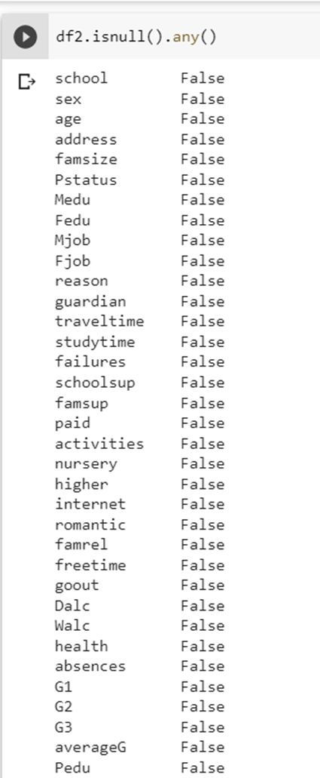
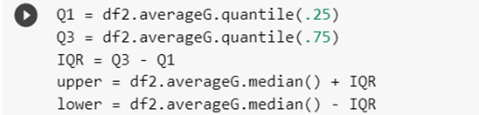
Data Preprocessing (Phase 1)
Any real-world data usually contains so much noises, missing values, categorical values that need to be transformed to numerical values.
Feature Creation:
averageG: which is the outcome of (G1+ G2+G3)/3
Pedu: which is the outcome of (Fedu + Medu )/2
Missing Values: no missing values
Outliers: cleared using IQR

Slide 7
Data Visualization
We used various approaches for various kinds of data such as count plot and box plot for categorical data and scatter plot for numerical data. Data visualization empowers us to look deeper into the data, understand more about the relations between different columns, and interpret the relations with a clearer vision. Therefore, we are going to address some plots and graphs with insights that's been taken from it.

Slide 8
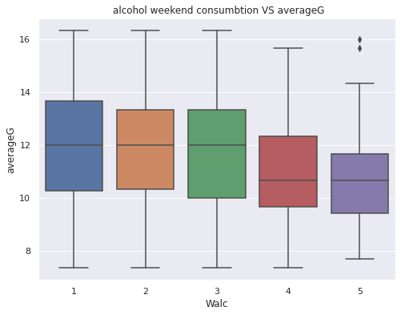
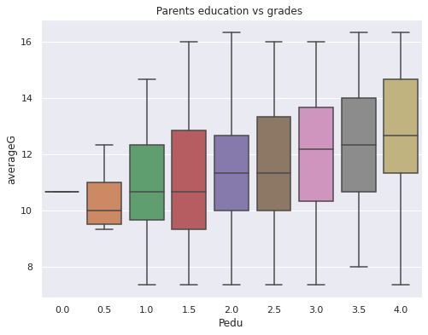
Data Visualization
As alcohol consumption on weekends increases, the average grade decreases.
As the level of parent's education increases, it reflects positively on the students' scores as it is noticeable in the boxplot graph

Slide 9
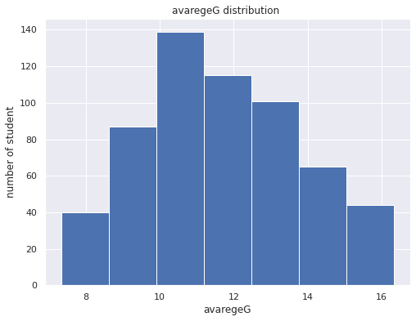
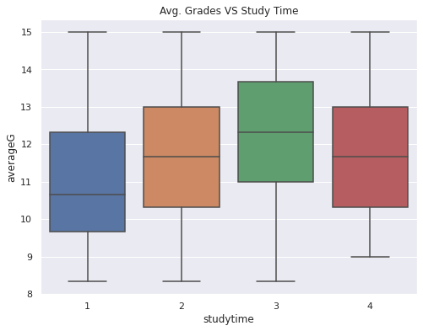
Data Visualization
the average grade distribution
Interestingly, higher study time does not mean higher grades.

Slide 10
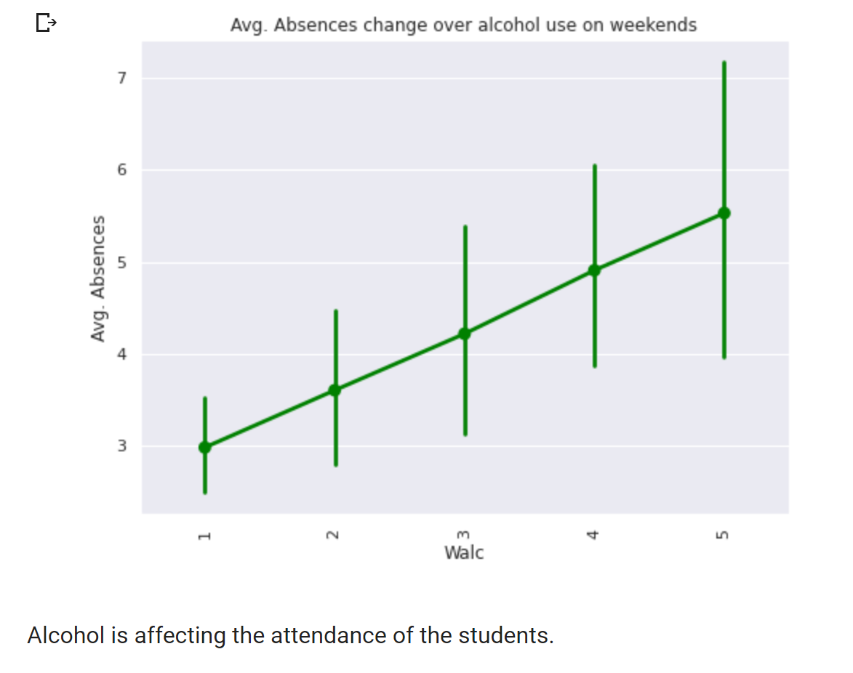
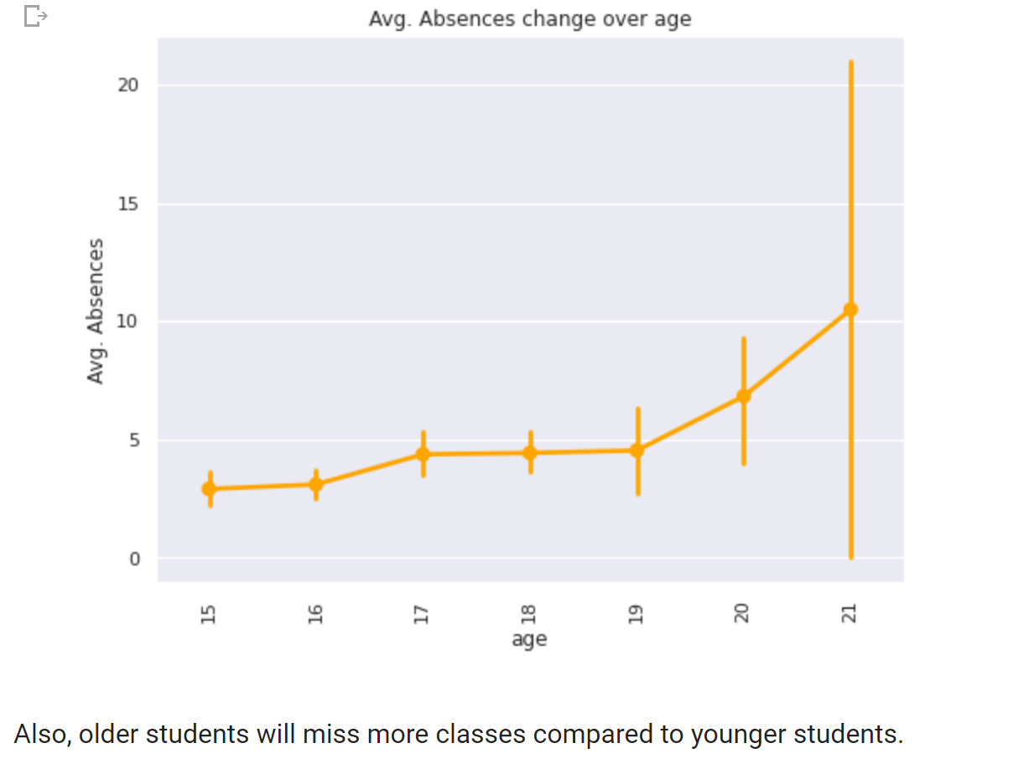
Data Visualization

Slide 11
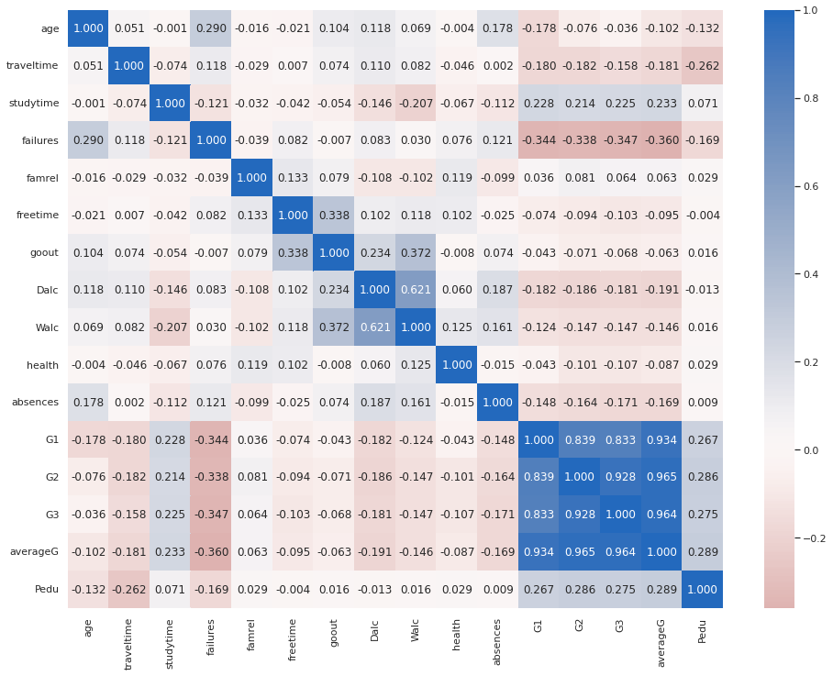
Data Visualization
Correlation Heatmap

Slide 12
Male vs Female Comparison
We can see clearly that female student on average 11.905714 has a much higher average grade than male student 11.345781.
Moreover, we can notice that female student study on average more time than male student also they are less likely to have a failure then male student.
Study time | Failures
2.060000 | 0.165714
1.734440 | 0.232365

Slide 13
In Relationship vs no Relationship
We can see that there is almost no relationship between students in relationship and average grade 11.635945, as well as students with no relationship and average grade 11.633690. Almost no effect is noted.

Slide 14
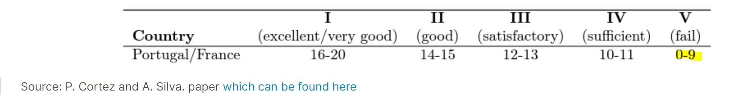
Data Preprocessing (Phase 2)
Feature Creation:
Pass: whether the student passed or failed
One-Hot Encoding:

Slide 15
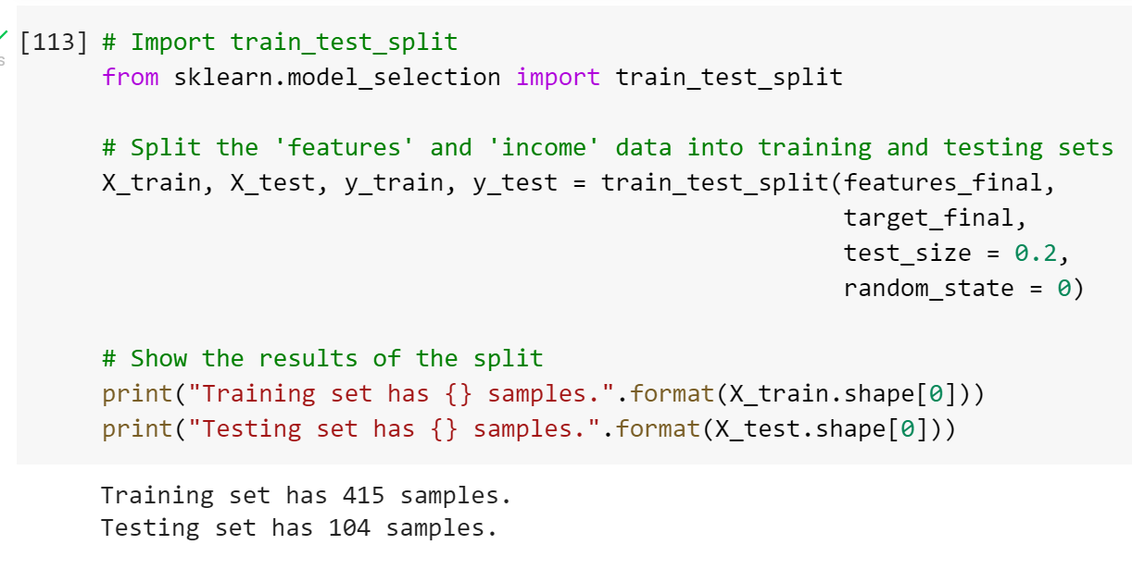
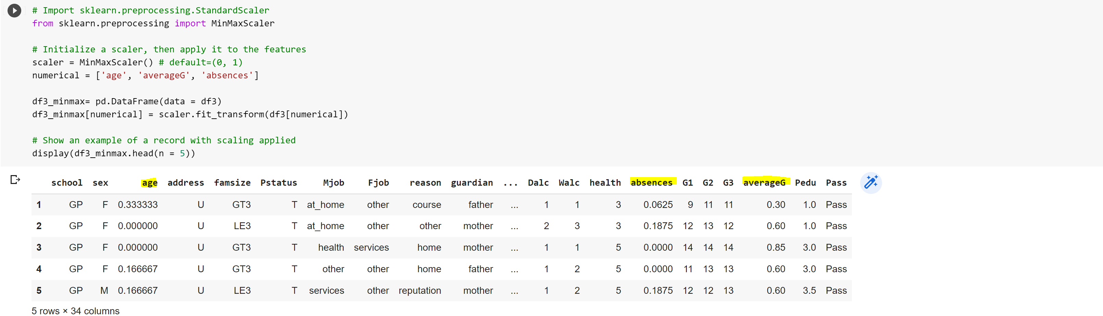
Data Preprocessing (Phase 2)
Shuffle and Split Data
Scaling numerical variables:

Slide 16
Methods
Multiple Linear Regression Analysis
Support Vector Machine
Classification Using Decision Tree
Classification Using Random Forest

Slide 17
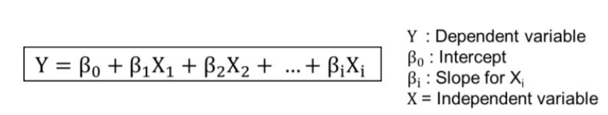
Multiple Linear Regression
Overview
One of the strongest techniques for prediction is the MLR which is used to predict dependent variables based on independent variables called predictors. and predictors can be quantitative or categorical. However, this method will be more efficient if there is a strong relation whatever negative or positive relation between the predictor and the output.

Slide 18
Multiple Linear Regression
Advantages and Disadvantages
disadvantages
Advantages | disadvantages
Linear Regression is straightforward to perform and easier to interpret the output coefficients. | Linear regression technique outliers can have large effects on the regression, and boundaries are linear in this technique, also it could give negative prediction.
Linear Regression is susceptible to over fitting, however it can be avoided using some dimensionality reduction techniques, such as cross validation. | susceptible to underfitting, this occurs when the hypothesis function cannot fit the data well.

Slide 19
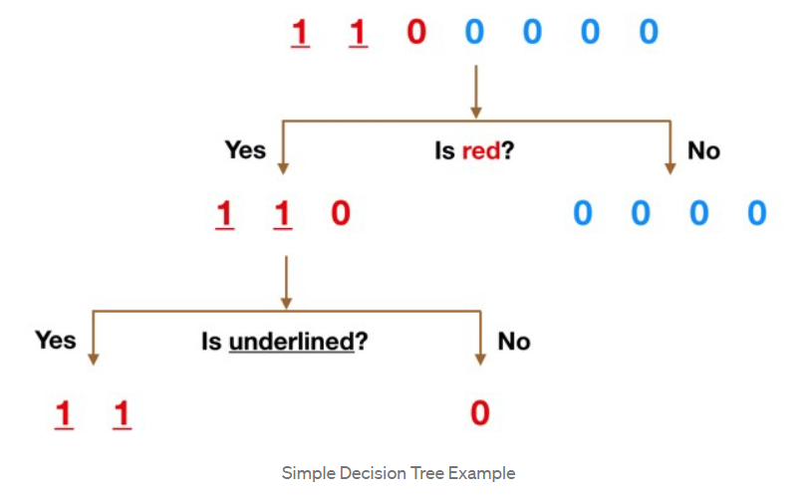
Decision Tree
Classification Using Decision Tree
A Decision Tree is a great classification method because it does not require any statistical assumption to be used. The reason for that is we have no probabilistic model, but just a binary split. Moreover, our data contains about 20 categorical variables which we can predict or use as input variables. What we can do is given a set of information about a student, we could predict unknown extra categorical information.

Slide 20
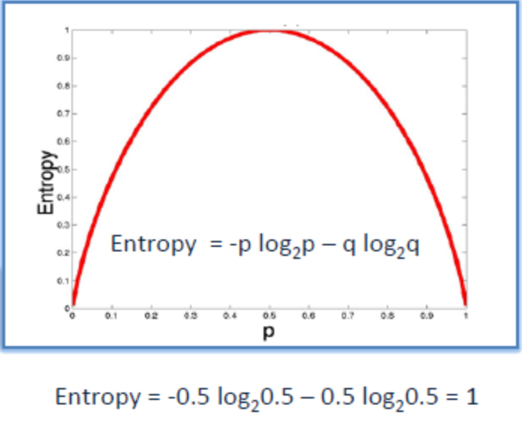
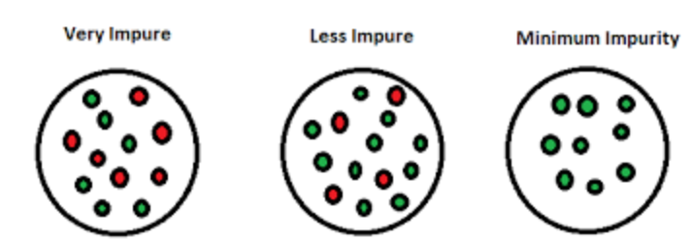
Decision Tree

Slide 21
Decision Tree
Advantages and Disadvantages
Advantages | Disadvantages
Simple to understand and to interpret. Trees can be visualized. | Decision-tree learners can create over-complex trees that do not generalise the data well.
Requires little data preparation. | Decision trees can be unstable because small variations in the data might result in a completely different tree being generated.
Able to handle both numerical and categorical data | Decision tree learners create biased trees if some classes dominate.

Slide 22
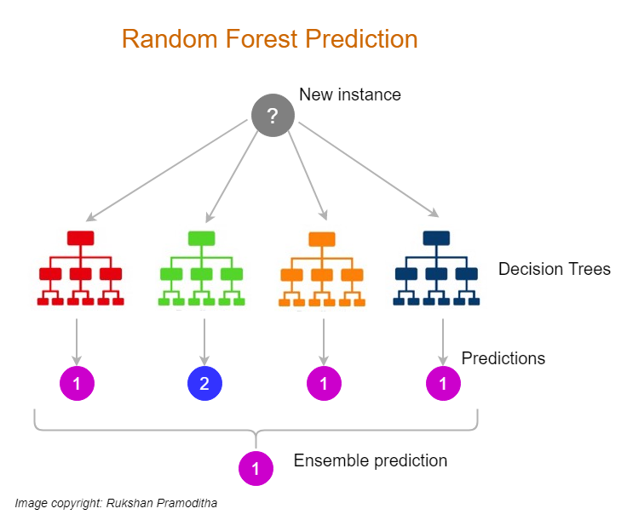
Random Forest
Classification Using Random Forest
The Random Forest classifier is fundamentally based on the Decision Tree. It consists of a large number of Decision Trees that behave as an ensemble statistical method. In the Random Forest, each tree will produce a class prediction. After that, the class with the highest votes becomes our prediction.

Slide 23
Random Forest
Advantages and Disadvantages
Advantages | Disadvantages
It gives variable importance which helps in determining the variable which impacts positively. | The main limitation of random forest is that a large number of trees can make the algorithm too slow and ineffective for real-time predictions.
It takes care of null values.
Often machine learning models are overfitted, random forest classifiers wouldn't get overfitted.
It can be used as a regression as well as classification model. | Random forest is a predictive modeling tool and not a descriptive tool.
The method also handles variables fast, making it suitable for complicated tasks.

Slide 24
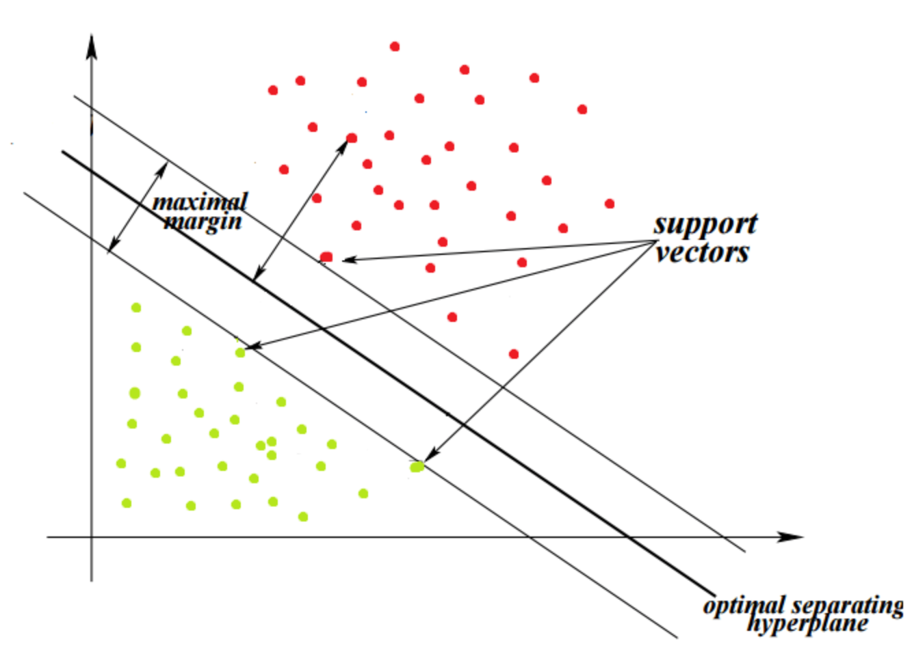
Support Vector Machines
One of the most popular supervised machine learning methods that can be useful for both classification and regression. Also, it’s called widest street and it works by separating the data to the class using a hyper-plane. It also aims to maximize the margin between classes.

Slide 25
Advantages and Disadvantages
Advantages | disadvantages
Effective in high dimensional spaces. | Not useful if the number of features is much greater than the number of samples,
Still effective in cases where number of dimensions is greater than the number of samples. | SVMs do not directly provide probability estimates, these are calculated using an expensive five-fold cross-validation.
Uses a subset of training points in the decision function (called support vectors), so it is also memory efficient.

Slide 26
Modeling
Linear Regression Modeling
Is there a relationship between the final grade and other student attributes? Can we predict averageG?
Classification Modeling
Can we know which student will continue their higher education? What are the factors?
Can we know which student will pass the course without knowing their grades?

Slide 27
Linear Regression Modeling

Slide 28
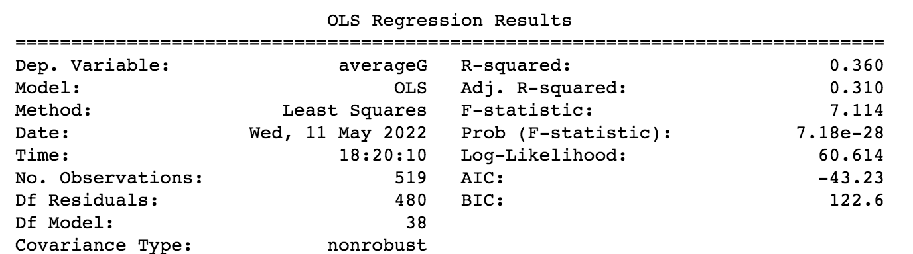
MLR Results
Using statsmodels library in python the first model was :

Slide 29
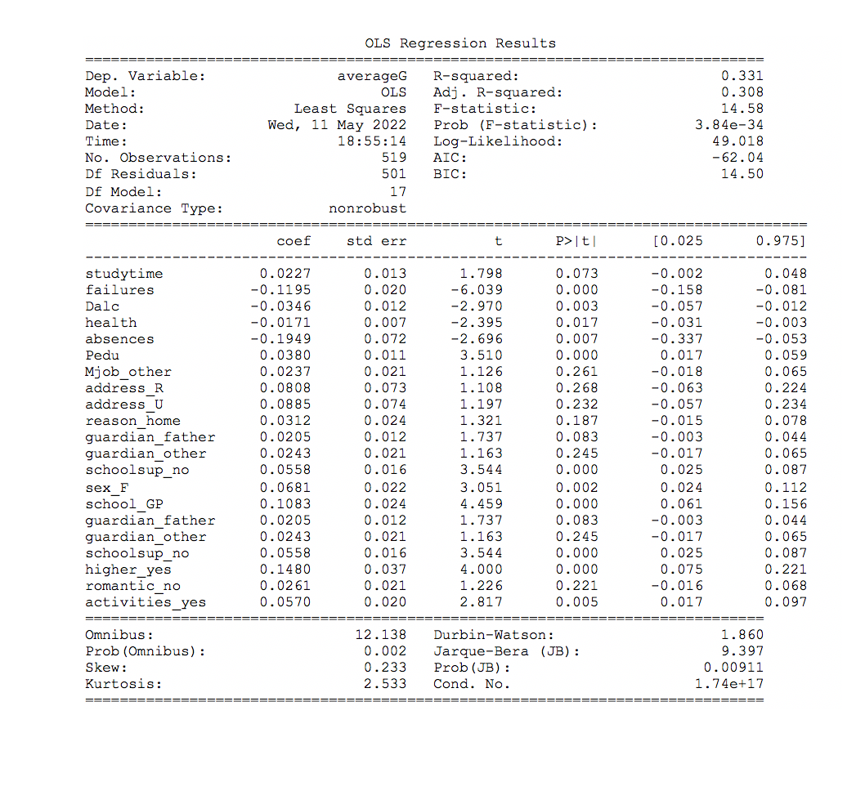
Backward Selection
After 10 iteration of Backward Selection R-squared decreased
RMSE =0.2143

Slide 30
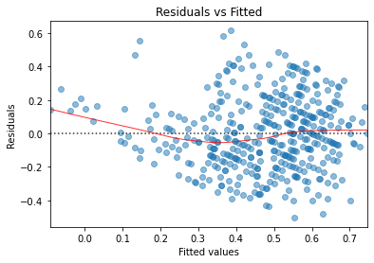
Potential problems with MLR
indicate that the absolute value of the residuals is strongly positively correlated with the fitted values, whereas no such trend is evident in the third plot. So if it were the case that, theoretically speaking, in a heteroscedastic linear model with normally distributed error , it violate one of the assumptions of the linear regression

Slide 31
Classification
Methodology of model selection:
We choose the best model out of the three classifiers (DT, RF, SVMs).
We perform GridSearchCV on the best classifier to get the optimized classifier.
We perform variable selection on the best optimized classifier.

Slide 32
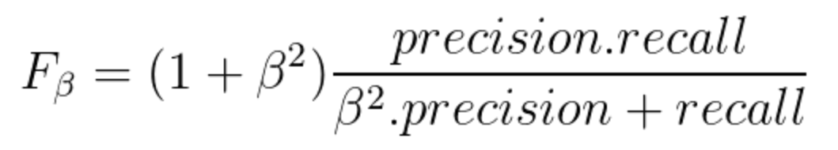

Classification Metrics
F-beta Score
The F-beta score is the weighted harmonic mean of precision and recall, reaching its optimal value at 1 and its worst value at 0.
The beta parameter determines the weight of recall in the combined score. beta < 1 lends more weight to precision, while beta > 1 favors recall (beta -> 0 considers only precision, beta -> +inf only recall).
Accuracy
$$accuracy=\frac{number of correct predictions}{number of total predictions}$$

Slide 33
Classification (I)

Slide 34
Classification (I)
Q: Which students wish to continue higher education?
Three Classifiers:
Decision Trees
Random Forest
Support Vector Machines (SVMs)

Slide 35
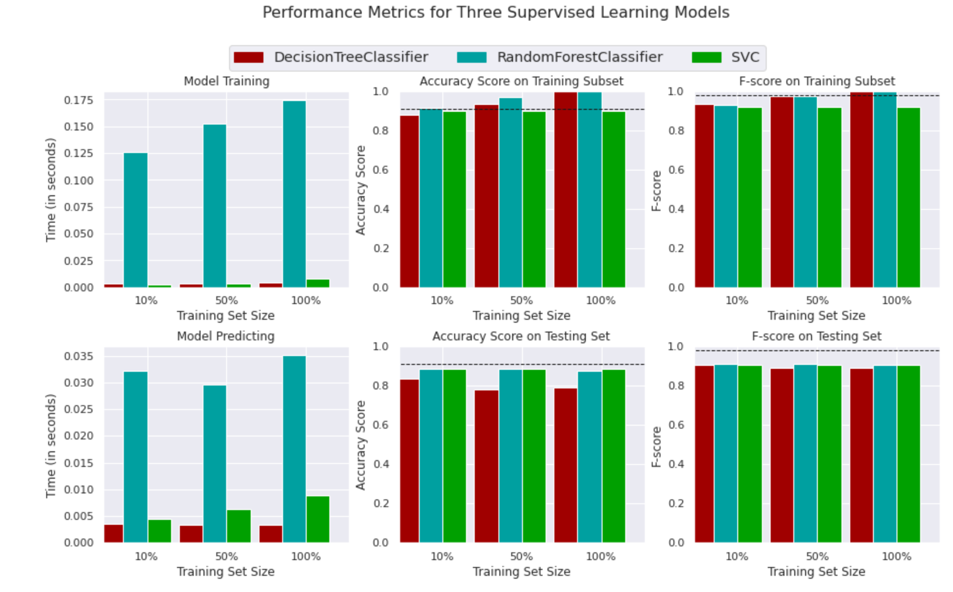
Training Phase

Slide 36
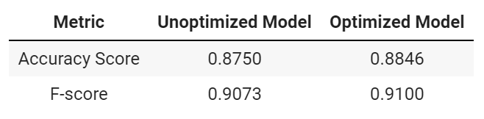
Tuning Phase
GridSearchCV
Exhaustive search over specified parameter values for an estimator.
Results after GridSearchCV:

Slide 37
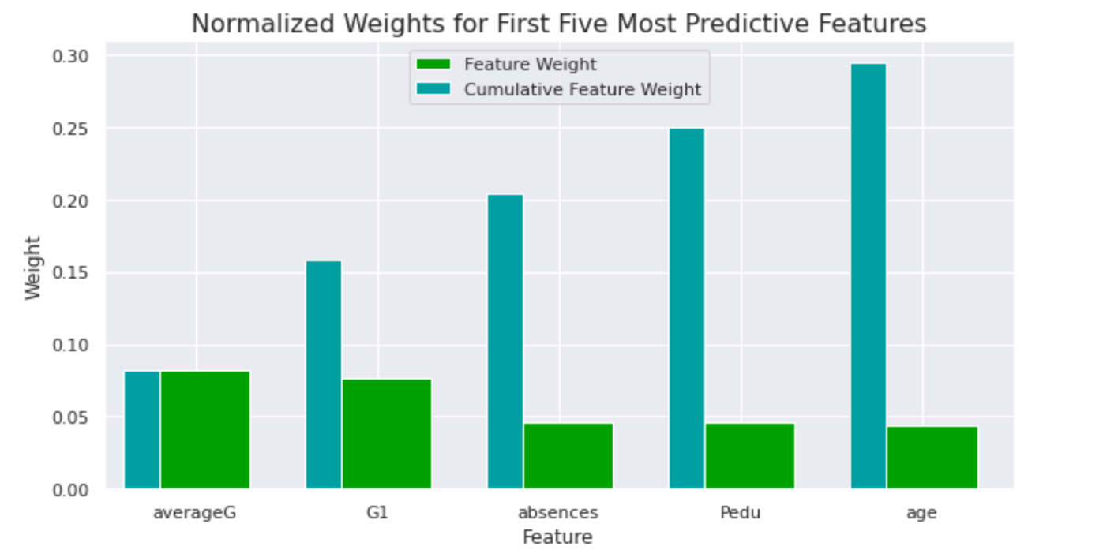
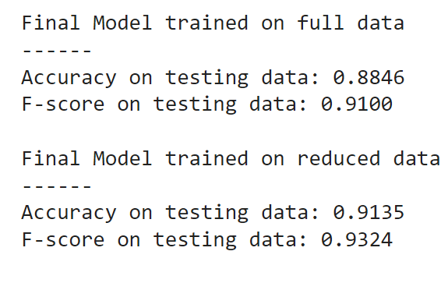

Feature Selection
Model After Reduction:

Slide 38
Classification (II)

Slide 39
Classification (II)
Q: Can we predict the whether the student will pass or fail without knowing the students grade?
Three Classifiers:
Decision Trees
Random Forest
Support Vector Machines (SVMs)

Slide 40
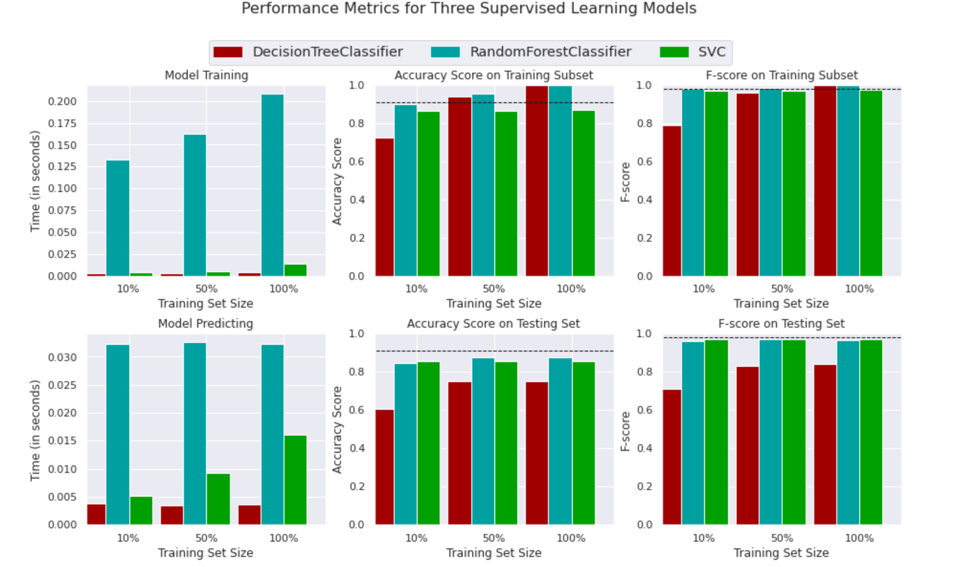
Training Phase

Slide 41
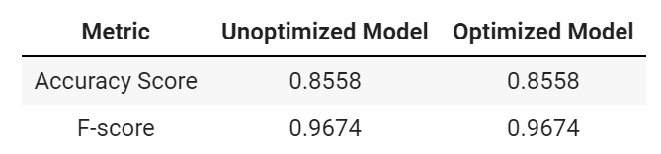
Tuning Phase
GridSearchCV
Exhaustive search over specified parameter values for an estimator.
Results after GridSearchCV:

Slide 42
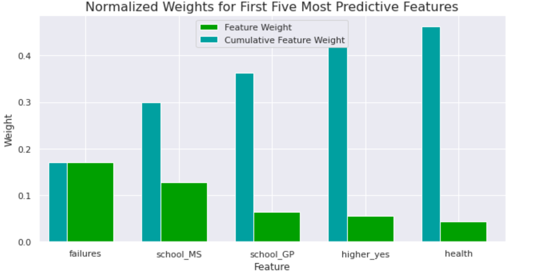
Feature Selection

Slide 43
Conclusions and Findings
MLR performed poorly due to some violations of regression assumptions
RF was the best classifier in the first classification problem
High F-score and high accuracy
SVM was the best classifier in the second classification problem
Not an easy task
High F-score and high accuracy

Slide 44
Thank you!

